Slide 1
Binary

Slide 2
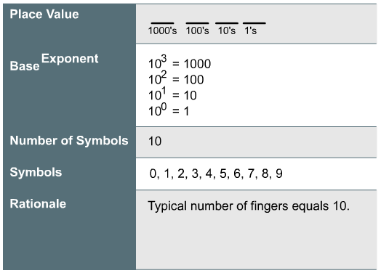
Base 10 Numbers

Slide 3
Base 10 numbers
Base 10 numbers use place value, for example in a four digit number, the first digit is the thousands place, the second the hundreds, the third the tens, and fourth the ones.
Place value is determined by exponents. The rightmost place is 10⁰ = 1, then, going left, 10¹ = 10, 10² = 100, and so on.
Base 10 uses ten symbols: 0, 1, 2, 3, 4, 5, 6, 7, 8, 9.

Slide 4
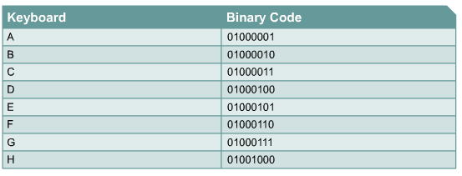
Binary Number System
Binary numbers are Base 2. Powers of two are used for place values. So the rightmost place value is 2⁰ = 1, then going left 2¹ = 2, 2² = 4, and so on.

Slide 5
Bits and Bytes
Units | Definition | Bytes (approx.) | Bits (approx.) | Examples
Bit (b) | Binary digit, a 1 or 0 |  | 1 bit | On/off, open/closed, +5 V or 0 V
Byte (B) | 8 bits | 1 byte | 8 bits | A single character (e.g. “X”) in ASCII code
Kilobyte (KB) | 1 kilobyte = 1024 bytes | 1000 bytes | 8000 bits | Typical email = 2 KB 10-page doc = 10 KB
Megabyte (MB) | 1 megabyte = 1024 kilobytes = 1,048,576 bytes | 1 million bytes | 8 million bits | Floppy disk = 1.44 MB Typical CPU cache = 4 MB
Gigabyte (GB) | 1 gigabyte = 1024 megabytes = 1,073,741,824 B | 1 billion bytes | 8 billion bits | Typical RAM = 8 GB
Terabyte (TB) | 1 terabyte = 1024 gigabytes | 1 trillion bytes | 8 trillion bits | Amount of data theoretically transmittable in optical fibre in one second.
Some sources will define these units as powers of 1000. So kilobyte = 1000 bytes etc., and will use kibibyte (KiB), mebibyte (MiB), gibibyte (GiB), and tebibyte (TiB) for definition based on 1024.

Slide 6
Converting Binary to Decimal
bit
exponent | 7 | 6 | 5 | 4 | 3 | 2 | 1 | 0
value | 128 | 64 | 32 | 16 | 8 | 4 | 2 | 1
2⁸ = 256
2⁷ = 128
2⁶ = 64
2⁵ = 32
2⁴ = 16
2³ = 8
2² = 4
2¹ = 2
2⁰ = 1
bit | 1 | 0 | 1 | 1 | 1 | 0 | 1 | 1
exponent | 7 | 6 | 5 | 4 | 3 | 2 | 1 | 0
value | 128 | 64 | 32 | 16 | 8 | 4 | 2 | 1
 | 128 |  | 32 | 16 | 8 |  | 2 | 1 | 187

Slide 7
POGIL - Converting Binary to Decimal and Decimal to Binary
Convert 10011101 into decimal
bit
exponent | 7 | 6 | 5 | 4 | 3 | 2 | 1 | 0
value | 128 | 64 | 32 | 16 | 8 | 4 | 2 | 1

Slide 8
POGIL - Converting Binary to Decimal and Decimal to Binary
Convert 10011101 into decimal
What if we had more than 8 bits?
bit | 1 | 0 | 0 | 1 | 1 | 1 | 0 | 1
exponent | 7 | 6 | 5 | 4 | 3 | 2 | 1 | 0
value | 128 | 64 | 32 | 16 | 8 | 4 | 2 | 1
 | 128 |  |  | 16 | 8 | 4 |  | 1 | 157

Slide 9
Converting Decimal to Binary
Subtraction method
Example: convert 171 into binary
128 fits into 171. Write down 1. 171 - 128 leaves 43. 1
64 does not fit into 43. Write down 0. 0
32 fits into 43. Write down 1. 43 - 32 leaves 11. 1
16 does not fit into 11. Write down 0. 0
8 fits into 11. Write down 1. 11 - 8 leaves 3. 1
4 does not fit into 3. Write down 0. 0
2 fits into 3. Write down 1. 3 - 2 leaves 1. 1
1 is 1. Write down 1. 1 - 1 leaves 0. Done. 1
So 171 = 10101011 in binary.
2⁸ = 256
2⁷ = 128
2⁶ = 64
2⁵ = 32
2⁴ = 16
2³ = 8
2² = 4
2¹ = 2
2⁰ = 1

Slide 10
Converting Decimal to Binary
Remainder method.
Divisor – Base | Dividend - Decimal | Remainder – Binary | Quotient
2 | 154 |  | 154 / 2 = 77 (0 remainder)
 | 77 | 0 | 77 / 2 = 38 (1 remainder)
 | 38 | 1 | 38 / 2 = 19 (0 remainder)
 | 19 | 0 | 19/2 = 9 (1 remainder)
 | 9 | 1 | 9 / 2 = 4 (1 remainder)
 | 4 | 1 | 4 / 2 = 2 (0 remainder)
 | 2 | 0 | 2 / 2 = 0 (0 remainder)
 | 1 | 0 | 1 / 2 = 0 (1 remainder)
 | 0 | 1
10011010

Slide 11
Converting Decimal to Binary
Checking your answer
Make sure you have the correct number of bits
Convert back to decimal to check if you converted correctly

Slide 12
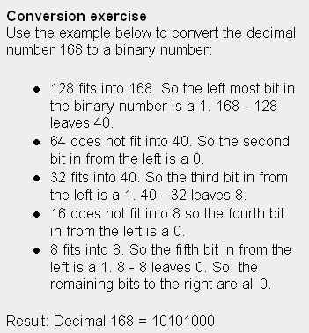
POGIL - Converting Binary to Decimal and Decimal to Binary
Convert:
72
Use remainder method or
subtraction method
245
707

Slide 13
POGIL - Converting Binary to Decimal and Decimal to Binary
Convert:
Use remainder method or
subtraction method
72
245
707

Slide 14
POGIL - Converting Binary to Decimal and Decimal to Binary
64 fits into 72. Write down 1. 72 – 64 leaves 8. 1
32 doesn’t fit into 8. 0
16 doesn’t fit into 8. 0
8 is 8. 1
Need to write zeros for 4, 2, 1. 0 0 0
01001000
often useful to write numbers as eight bits with leading zeros

Slide 15
POGIL - Converting Binary to Decimal and Decimal to Binary
Divisor – Base | Dividend - Decimal | Remainder – Binary | Quotient
2 | 245 |  | 245 / 2 = 122 (1 remainder)
 | 122 | 1 | 122 / 2 = 61 (0 remainder)
 | 61 | 0 | 61 / 2 = 30 (1 remainder)
 | 30 | 1 | 30 / 2 = 15 (0 remainder)
 | 15 | 0 | 15 / 2 = 7 (1 remainder)
 | 7 | 1 | 7 / 2 = 3 (1 remainder)
 | 3 | 1 | 3 / 2 = 1 (1 remainder)
 | 1 | 1 | 1 / 2 = 0 (1 remainder)
 | 0 | 1
Read bottom to top: 11110101

Slide 16
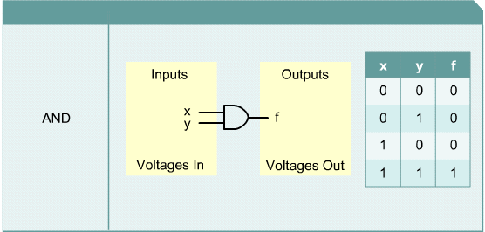
Boolean Logic
AND
OR
NOT
XOR

Slide 17
Extras – Binary Numbers
Binary numbers in 60 seconds
http://www.youtube.com/watch?v=qdFmSlFojIw
Binary - So Simple a Computer Can Do It
http://www.kerryr.net/pioneers/binary.htm
Cisco Binary Game
http://forums.cisco.com/CertCom/game/binary_game_page.htm

